Slide 1
SECURE DATA HIDING IN IMAGES USING STEGANOGRAPHY
CAPSTONE PROJECT
Presented By: Ladi Gayathri
Student Name: Ladi Gayathri
College Name & Department: Vignan’s Institute of Engineering for Women, Computer Science and Engineering(CSE)

Slide 2
OUTLINE
Problem Statement
Technology used
Wow factor
End users
Result
Conclusion
Git-hub Link
Future scope

Slide 3
Problem Statement
Traditional data transmission methods are prone to interception and unauthorized access, making sensitive information vulnerable.
This project enhances data security using image-based steganography, which embeds secret messages within digital images.
The hidden data remains undetectable to the human eye, ensuring secure communication.
This method provides a reliable way to protect confidential information during transmission.

Slide 4
Technology used
Programming Language: Python
Frameworks & Libraries: Flask, React.js, PIL (Pillow), Stegano
Tools: VS Code, Postman, GitHub
Hosting: Localhost (Flask backend & React frontend)
Platforms: Can be used for secure communication in messaging apps, confidential data transfer in corporate environments, and secure document sharing in government and defense sectors.

Slide 5
Wow factors
Invisible Yet Secure – The hidden message is seamlessly embedded into an image without altering its visual appearance, making it undetectable to the human eye.
Dual Functionality – The project supports both encoding (hiding text inside images) and decoding (extracting hidden messages), ensuring a complete steganography solution.
User-Friendly Interface – Built with React.js, providing an interactive and easy-to-use frontend for smooth user experience.
Future Scalability – Can be extended to support audio and video steganography, enhancing security for multimedia data transmission.
Cross-Platform Compatibility – Works on Windows, macOS, and Linux, making it accessible across different environments.
Potential for AI Integration – Future enhancements can include AI-based pattern detection to make steganography even more robust and intelligent.

Slide 6
End users
Cybersecurity Professionals – Can use steganography for secure data transmission and encryption research.
Journalists & Whistleblowers – Helps in safely sharing confidential information without detection.
Government & Military Communications – Ensures secure and covert exchange of classified data.
Businesses & Corporations – Protects sensitive documents and internal communications from cyber threats.
General Users Needing Privacy – Ideal for anyone who wants to send hidden messages securely over digital platforms.

Slide 7
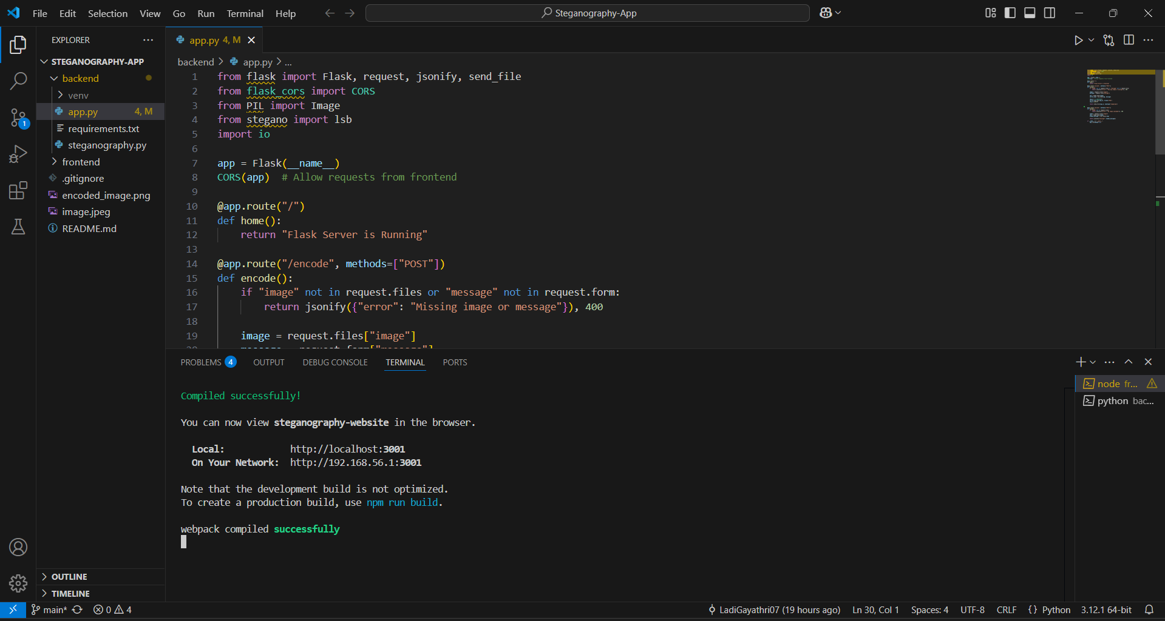
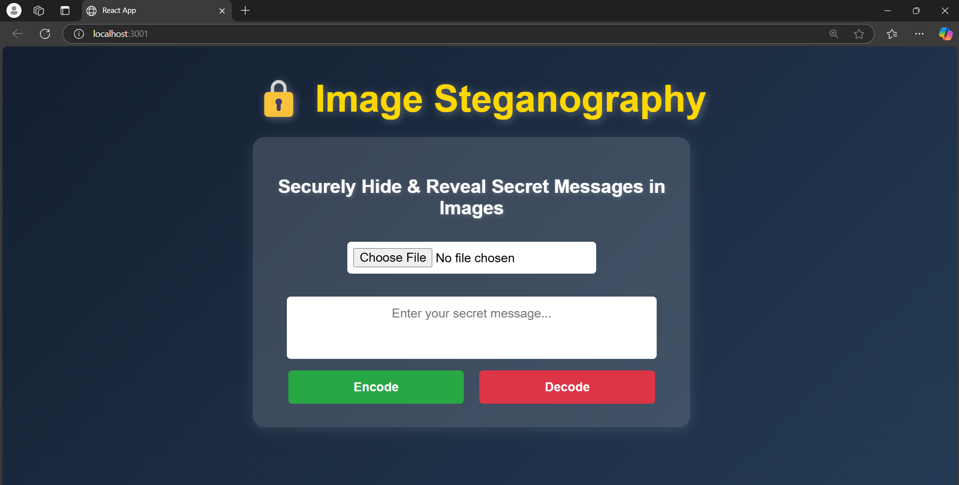
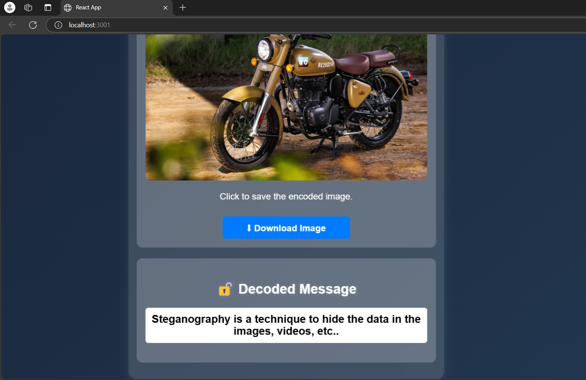
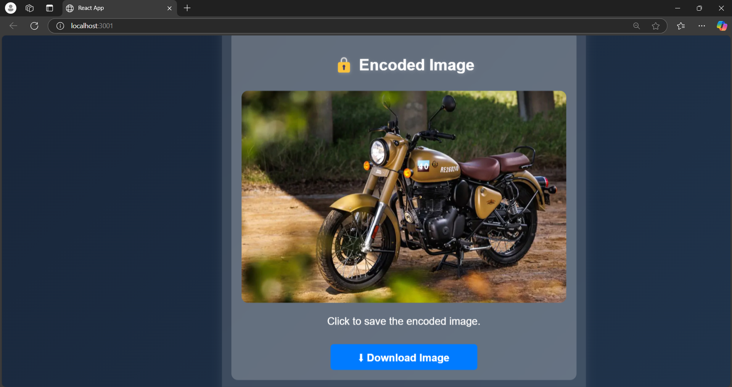
Results

Slide 8
Conclusion
This Steganography App demonstrates how digital images can be used for secure communication by embedding hidden messages. The project successfully encodes and decodes text messages within images while maintaining their visual integrity. This approach enhances security in sensitive communications. By integrating Flask for backend processing and React.js for a user-friendly interface, the system ensures seamless and efficient message concealment and retrieval. This approach significantly enhances data security, making it useful for private communications, corporate confidentiality, and government security applications.

Slide 9
GitHub Link
https://github.com/LadiGayathri07/Steganography-App.git

Slide 10
Future scope(optional)
Implement stronger encryption for additional security
Develop a mobile application for easy access
Deploy the project on a cloud-based platform for wider use
Support for other media formats like audio & video steganography

Slide 11
THANK YOU

